Slide 1
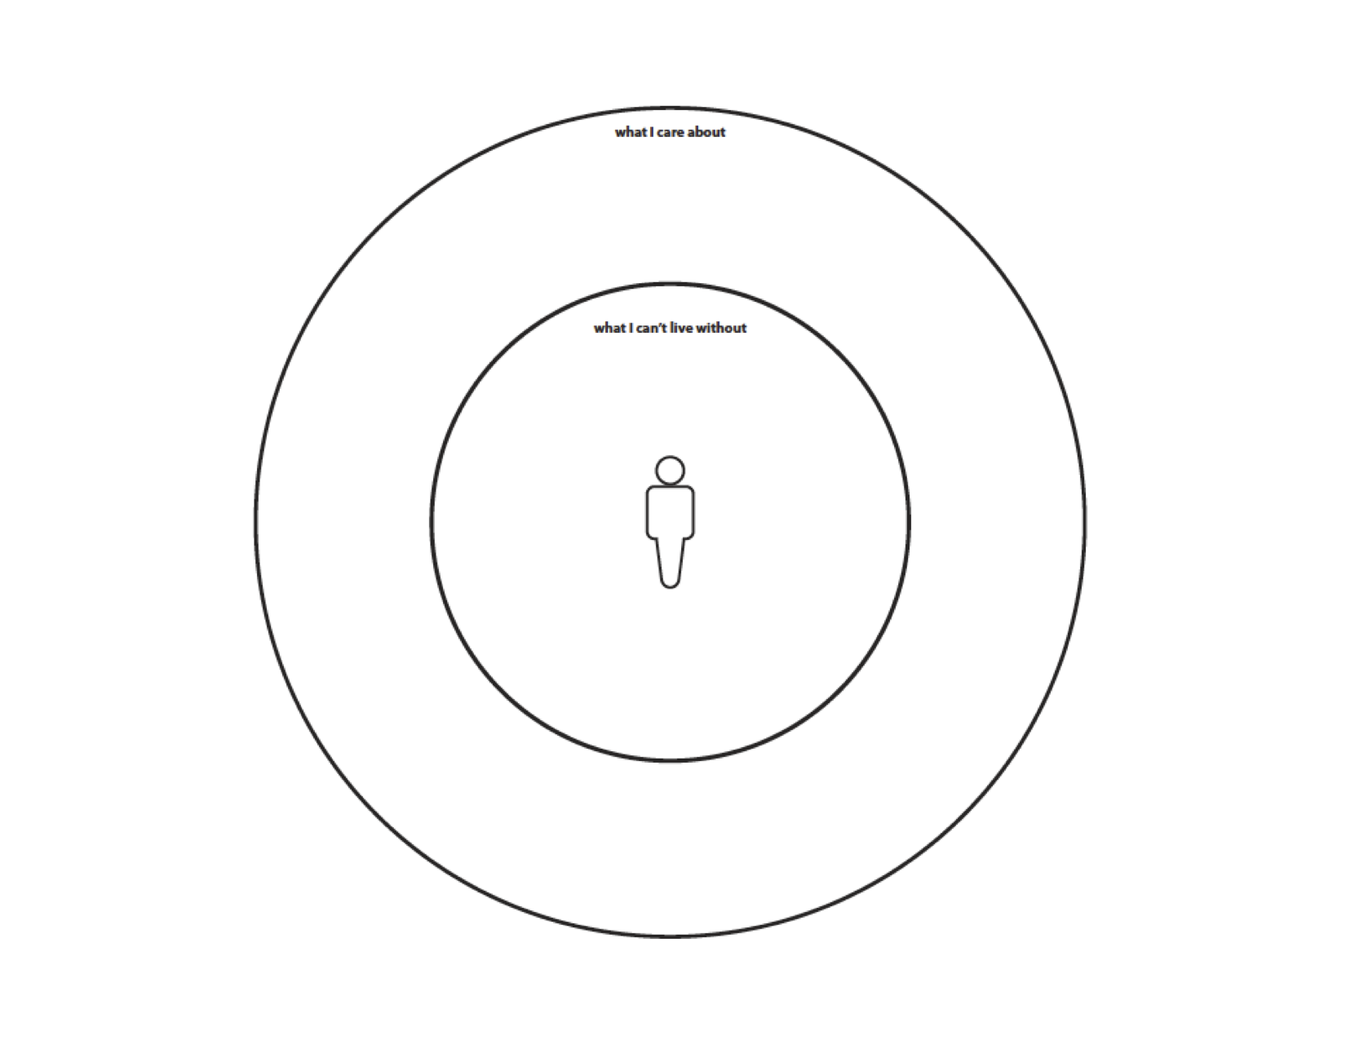




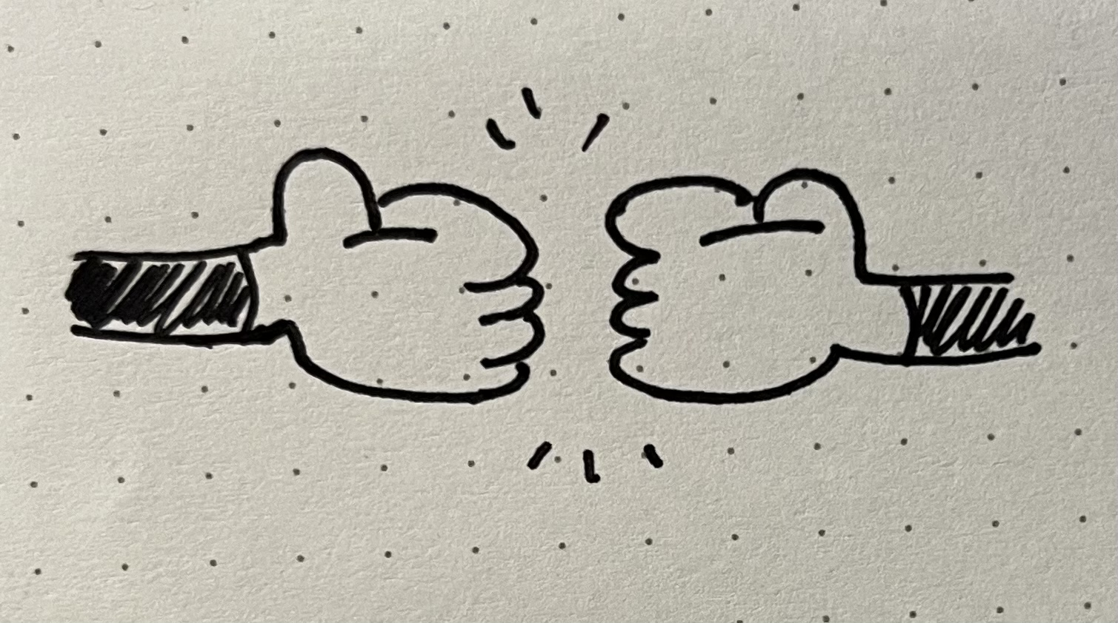




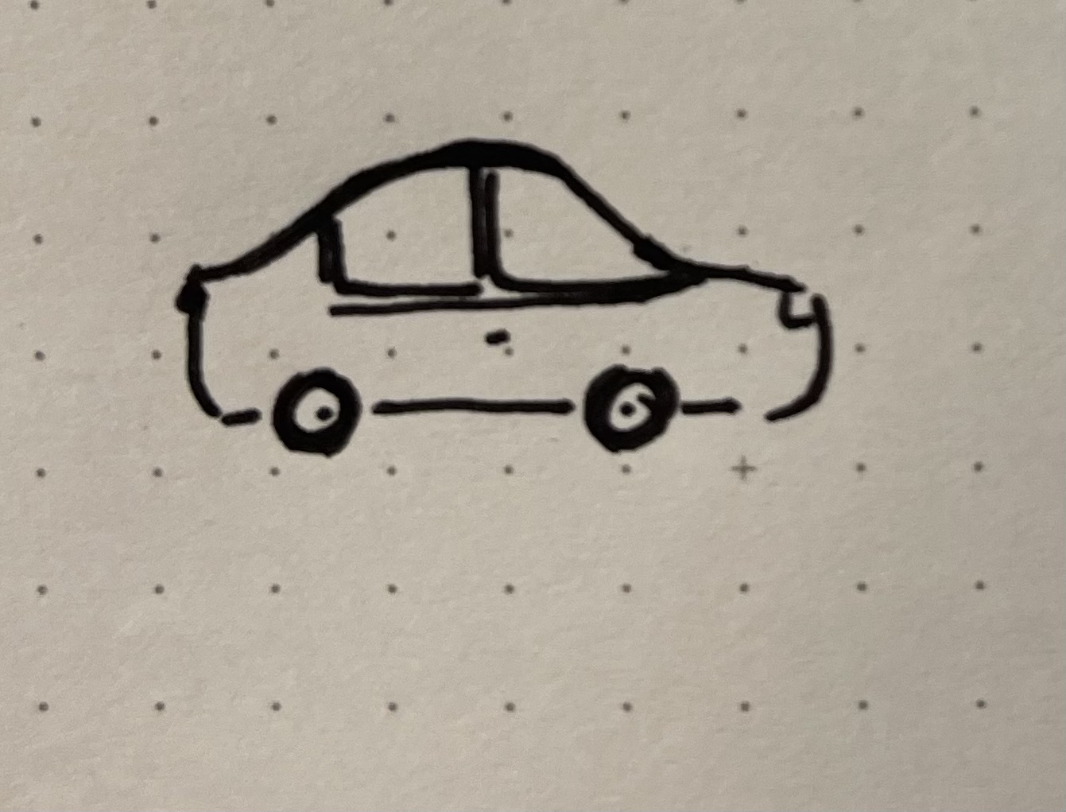
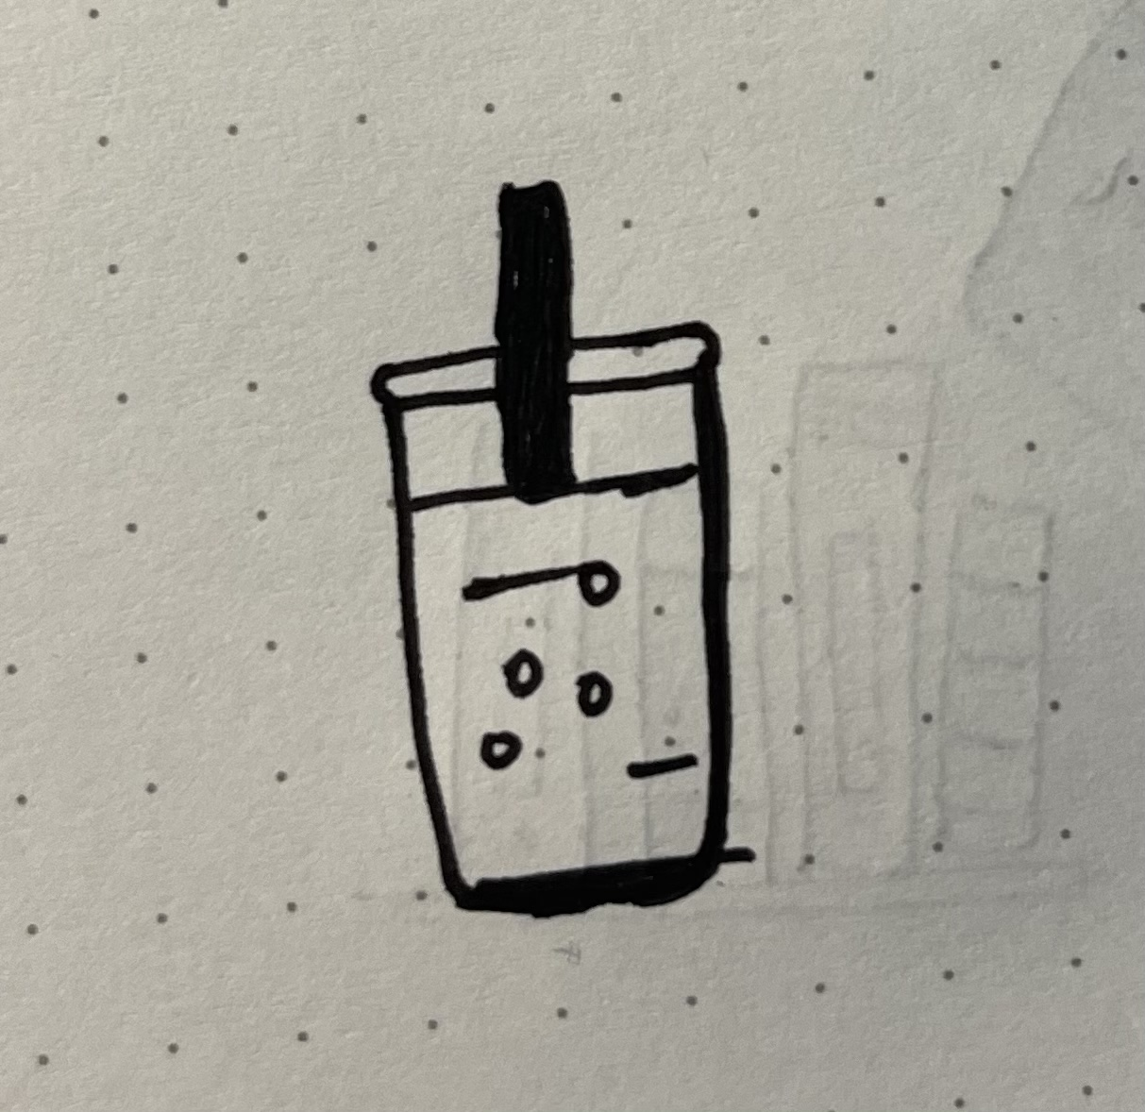


Slide 2
Very Experienced
FAMILY
FINANCIAL
EDUCATION
MUSIC
PROGRAMMING
No Interest
Fascinated
CLIMATE
HEALTH/WELLNESS
TOURISM/TRAVEL
CONSTRUCTION
AGRICULTURAL
ENERGY
ENTERTAINMENT
No Experience

